Slide 1
HDLC,PPP,Media access control

Slide 2
HDLC - Introduction
High-level Data Link Control
It is used in Datalink layer for multiple data transfer
Bit oriented communication protocol
Used to connect multiple network systems.It applies the ARQ protocol for application and establishes a full-duplex communication channel

Slide 3
HDLC Stations
Primary - establishes and de-establishing primary data channel to share frames in the network known as commands. Performs data management for network
Secondary - Works under command of primary station, and frames issued by this station are known as responses
Combined - Both primary and secondary

Slide 4
HDLC Transfer models
NRM - Normal Response Model (NRM):
This model combines primary and secondary stations in point-to point or multi point network configuration to exchange commands from primary and responses from secondary.
Here only Sender (primary node) and send the data packets. The receiver (secondary) just send the acknowledgement

Slide 5
Transfer model
Asynchronus Balanced Model (ABM):
Combined stations are installed in a point to point configuration for exchange commands and responses in balanced format.
Here both sender and receiver can send data

Slide 6
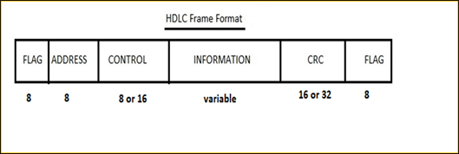
HDLC Frame

Slide 7
Flag Field: It marks the beginning of the frame and termination of the frame. Each frame starts and ends with the flag bit. It is defined by an 8 bit octet sequence 01111110.
Address Field: It encapsulates the receivers address.
Control Field: It contains information about the flow and error control in byte format
Payload/Information Field : This field carries the information that to be transfered
FCS Field : This field stands for Frame check Sequence and acts as error detection field in HDLC protocol
Which includes the 16 bit CRC check bit

Slide 8
Frame models
I- Frames - Information Frame - It is applied to encapsulate the user information from upper layer in the model and then then transmit to network channel. The control bit will 0 indicating that this is a I-Frame model
S-Frame - Supervisory frames - Used for error and data flow control and does not contain the information field in the frame format. First two bits of the control field in 1 and 0 indicating S-Frame
U-Frame - Un-numbered frame - used for system management and exchanging information between the connected network devices

Slide 9
PPP- Introduction
Used to make point to point communication.
WAN protocol
Widely used in broadband communication
Home computers ------------> Servers
Services:
Authentication
Frames - Send frames between the data link layer of one device to another device
Multilink - Newer version support multiple connection

Slide 10
PPP - Frame
Flag : Indicating Beginning and Termination of frame. It is of the form 01111110
Address : Address of the receiver. If we are trying to broadcast something then the address will 11111111
Control : Error control
Protocol : Tells what type of data is being transfered
Payload/Data : Actual data
FCS: Contains the CRC to correct the errors if any.

Slide 11
Byte stuffing
Why byte stuffing ?
It is process adding an extra byte whenever there is a flag sequence appear in payload. It is added so that the receiver will not take it as the end of the frame

Slide 12
Multiple access Control
The Data Link Layer is responsible for transmission of data between two nodes. Its main functions are-
Data Link Control
Multiple Access Control

Slide 13
Data Link control – The data link control is responsible for reliable transmission of message over transmission channel by using techniques like framing, error control and flow control.
Multiple Access Control – If there is a dedicated link between the sender and the receiver then data link control layer is sufficient, however if there is no dedicated link present then multiple stations can access the channel simultaneously. Hence multiple access protocols are required to decrease collision and avoid crosstalk.

Slide 14
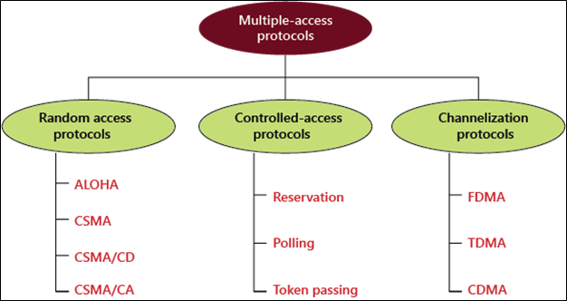
Types of Multiple-access

Slide 15
Random Access Protocols
Random Access Protocol: In this, all stations have same superiority that is no station has more priority than another station. Any station can send data depending on medium’s state( idle or busy)

Slide 16
ALOHA
ALOHA – It was designed for wireless LAN but is also applicable for shared medium. In this, multiple stations can transmit data at the same time and can hence lead to collision and data being garbled.
Pure Aloha: When a station sends data it waits for an acknowledgement. If the acknowledgement doesn’t come within the allotted time then the station waits for a random amount of time called back-off time (Tb) and re-sends the data. Since different stations wait for different amount of time, the probability of further collision decreases.
Slotted Aloha: It is similar to pure aloha, except that we divide time into slots and sending of data is allowed only at the beginning of these slots. If a station misses out the allowed time, it must wait for the next slot. This reduces the probability of collision.

Slide 17
CSMA
CSMA – Carrier Sense Multiple Access ensures fewer collisions as the station is required to first sense the medium (for idle or busy) before transmitting data. If it is idle then it sends data, otherwise it waits till the channel becomes idle.
CSMA/CD – Carrier sense multiple access with collision detection. Stations can terminate transmission of data if collision is detected.
CSMA/CA – Carrier sense multiple access with collision avoidance. The process of collisions detection involves sender receiving acknowledgement signals.

Slide 18
Controlled Access
Reservation
In the reservation method, a station needs to make a reservation before sending data.
The timeline has two kinds of periods:
Reservation interval of fixed time length
Data transmission period of variable frames.
Polling
Polling process is similar to the roll-call performed in class. Just like the teacher, a controller sends a message to each node in turn.
In this, one acts as a primary station(controller) and the others are secondary stations. All data exchanges must be made through the controller.
The message sent by the controller contains the address of the node being selected for granting access.

Slide 19
Token Passing
In token passing scheme, the stations are connected logically to each other in form of ring and access to stations is governed by tokens.
A token is a special bit pattern or a small message, which circulate from one station to the next in some predefined order.

Slide 20
Channelization
Channelization: In this, the available bandwidth of the link is shared in time, frequency and code to multiple stations to access channel simultaneously.
Frequency Division Multiple Access (FDMA) – The available bandwidth is divided into equal bands so that each station can be allocated its own band.
Time Division Multiple Access (TDMA) – In this, the bandwidth is shared between multiple stations. To avoid collision time is divided into slots and stations are allotted these slots to transmit data.

